Slide 1
Exercise 3: sampling
See example Notebook: sampling
Load the class data csv file from the previous exercise
Choose a variable
Create 3 lists:
100 means of random samples (with replacement) of n=1 of your variable
100 means of random samples of n=5
100 means of random samples of n=10
Create density plots of each list. Do you see evidence of the central limit theorem?
Extra challenge: superimpose the density plots in one plot, with differing colors

Slide 2
Tips for graphs
Keep it simple, stupid (KISS)
Don’t use 3D
Don’t use pie charts (too often)
Give a title and label your axes

Slide 3

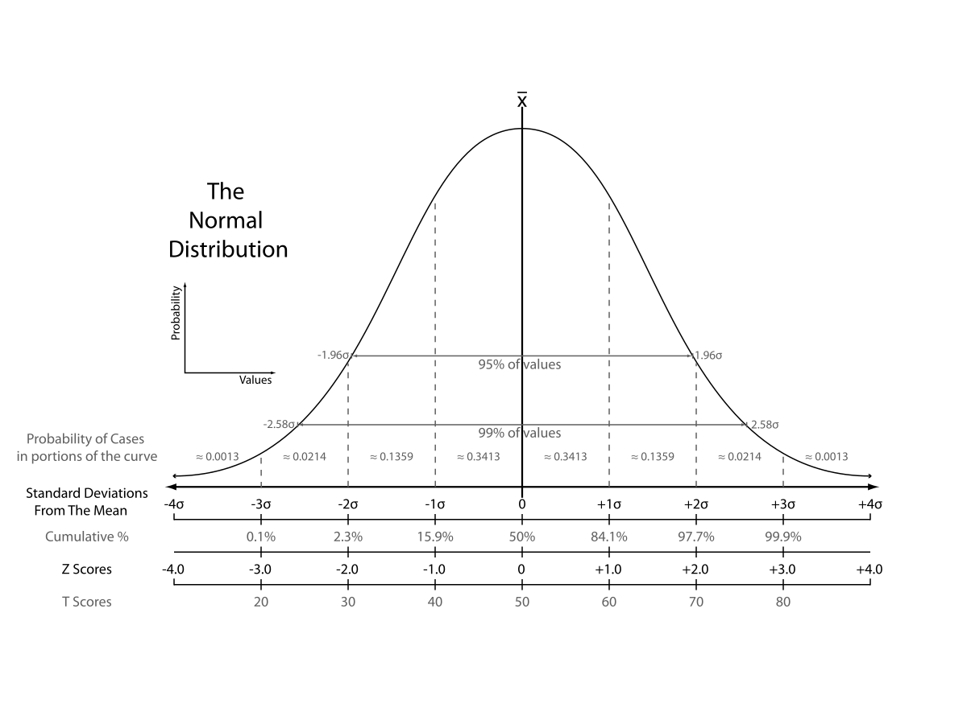
Normal distribution

Slide 4
Why is the normal distribution so important?
Some distributions in real life approach the ND
The ND is assumed in a lot of statistical modelling
Central limit theorem

Slide 5
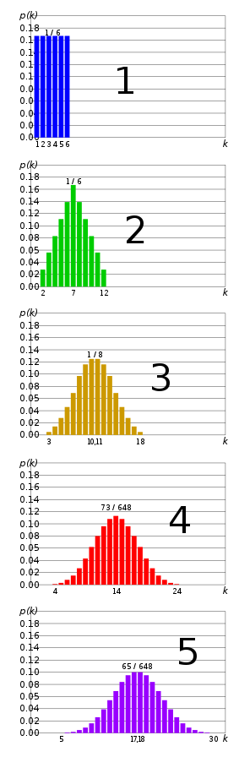
Central limit theorem
Sum of independent, identical distributions approaches normal distributions
See right: sum of 1…5 dice
Same goes for sampling distribution of the mean -> larger n, closer to normal

Slide 6
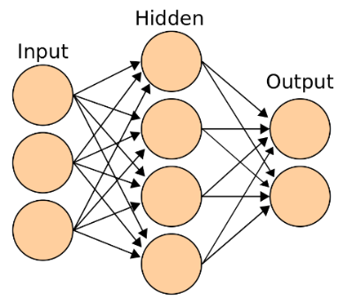
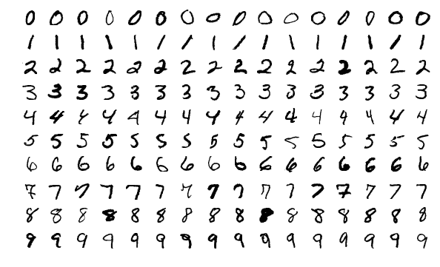
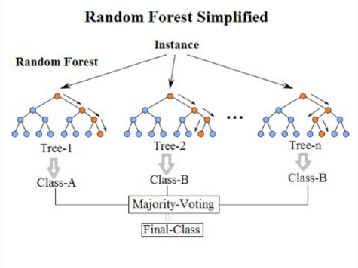

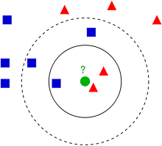

Example algorithms and applications
Algorithms
Applications
Neural network (deep learning)
playground
Random Forest
k-nearest neighbor

Slide 7
Common transformations
Data | Transformation
Multiple similar items on survey on happiness ‘I’m happy with the way things are going’ ‘I’m happy with my life’ | Sum or mean
Population Land area | Ratio (population/land area)
Date: 20-12-2010 | Numbers of days from start
Very right-skewed variables, e.g. YouTube views, income | ¹⁰Log(x) ¹⁰Log(10) = 1 ¹⁰Log(100) = 2 ¹⁰Log(1000) = 3

Slide 8
More machine learning…
Algorithms
Applications
Neural network (deep learning)
playground
Random Forest
k-nearest neighbor
And many, many more…

Slide 9
Exercise 2
First, install graphviz using:
conda install graphviz
conda install python-graphviz
Continue with the Titanic data set and the same variables that you selected. See the decision_tree Notebook for example code. It does not contain excess code (things shown elsewhere).
Split the data into a training and a test set
Train a decision tree on the training data set and visualize it. How do you interpret the tree? Who survived the Titanic?
Evaluate the performance of the tree on the test set. Is it better or worse than the k-NN that you used earlier?
Experiment with different parameter settings

Slide 11
Distance
Which is closest, user 1&2 or 2&3?

Slide 12
Euclidean distance
Euclidean distance: user 1&2 are closer!

Slide 13
Exercise 2: recommender systems
Work together in couples or groups of 3. Have a look at the full Movielens data set (including tags.csv) and write down the answers to the following questions, to be discussed later in class.
Which elements of the Movielens data set can be used for collaborative filtering? How could we use it in a recommender system?
Which elements of the Movielens data set can be used for content filtering? How could we use it in a recommender system?
Which problems do you envision with a recommender system based on the Movielens data, or recommender systems in general? Name at least 3 problems.

Slide 14
Cosine similarity
When the direction is more important than the magnitude, cosine similarity works better than Euclidean distance
Cosine similarity is the angle between the vectors of the two users
As users use different rating magnitudes (some very positive, some more negative), we use the cosine similarity

